Slide 1
Nurse Refresher-Nurse Reactivation Program
Information Session
Fall 2023 and Spring 2024

Slide 2
Objectives
Differentiate between the 2 courses within the Nurse Refresher-Reactivation Program
Define the eligibility criteria
Review the clinical requirements
Discuss Program costs

Slide 3
Nurse Refresher-Reactivation Program
12 Week Course
Online asynchronous theory via Canvas (First week in person on Blue Bell Campus, TBD) 2 and 3 component course
Lab on Blue Bell Campus (Thursday) 2 and 3 component course
Clinical at designated agency arranged through the Nursing Program. (Saturday) 3 component course
Approved by the PASBON
All licenses will be verified as active/inactive/lapsed through the State Board of Nursing prior to the student being able to attend any portion of the program. If a license cannot be verified, the student will be unable to attend the program.

Slide 4
Nurse Refresher
Designed for Registered Nurses with an active Pennsylvania RN license in Good Standing
Away from practice for less than 5 years
Wish to refresh their med-surg nursing knowledge and skills.
12-week course
2 Component Nurse Refresher or 3 Component Nurse Refresher-Reactivation Course

Slide 5
Nurse Refresher Curriculum
2-Component Course
Theory- 60 hours
Laboratory- 40 hours
No clinical attached to this course

Slide 6
Nurse Reactivation
Designed for Registered Nurses with an inactive/lapsed Pennsylvania RN license
Away from practice more than 5 years
Seeking reinstatement or renewal
Wish to refresh their med-surg nursing knowledge and skills.
Attendance to all class, lab and clinical is MANDATORY
There is one make-up day for clinical and lab scheduled within the course.
Required to take Comprehensive Predictor Exam

Slide 7
Nurse Reactivation Curriculum
3 Component Course
Theory- 60 hours
Laboratory-40 hours
Clinical- 80 hours

Slide 8
Nurse Refresher-Reactivation Class Schedule
Theory: Asynchronous via Canvas
Laboratory: Thursday, 6-9 pm, on Blue Bell campus
1 hour pre-lab preparation requirement
Clinical: Saturday, 1- 8 hour, 7a-3:30 p, 6- 12 hour, 7a-7:30 p
Clinical agency determined by the Nursing Program

Slide 9
Tuition- Lab Fee-Books
2 Component Course Tuition
$2,400
3 Component Course Tuition
$2,850
Lab Fee
$50
ATI-Electronic Books
$575
Nurse Pack
$28.78 (kit number K3894)

Slide 10
Clinical Course Fees
Castle Branch-$134
Assist with screenings and background checks
Online repository for clinical documents
Fee covers:
PA Background Check
FBI Fingerprinting
Drug Urine Test
Assists with establishing an account for PA Child Abuse Check

Slide 11
Clinical Requirements
Background Checks
Drug Screen
Immunizations including Covid 19 and Flu vaccines
Equipment-stethoscope and watch with a second hand
Scrubs-white top and navy bottom
Navy Skirt and/or dress are permitted

Slide 12
Clearances and Drug Screen
Drug Screen- order on CastleBranch- print a ticket and take to the lab listed on the site
PA Child Abuse Check- For Employment or Other NOT Volunteer
PA Criminal Abuse Check- order on CastleBranch
FBI Fingerprinting- Enter code on CastleBranch, get fingerprinted at site, upload results when received
Service Code- 1KG756

Slide 13
Specific Immunization Needs
Dates Immunization given
Titres indicating immunity- must attach lab results
Tdap within 10 years- Td not accepted
2 step PPD on program entry- this requires 4 visits to the healthcare provider OR
Quantiferon Gold or Chest x-ray

Slide 14
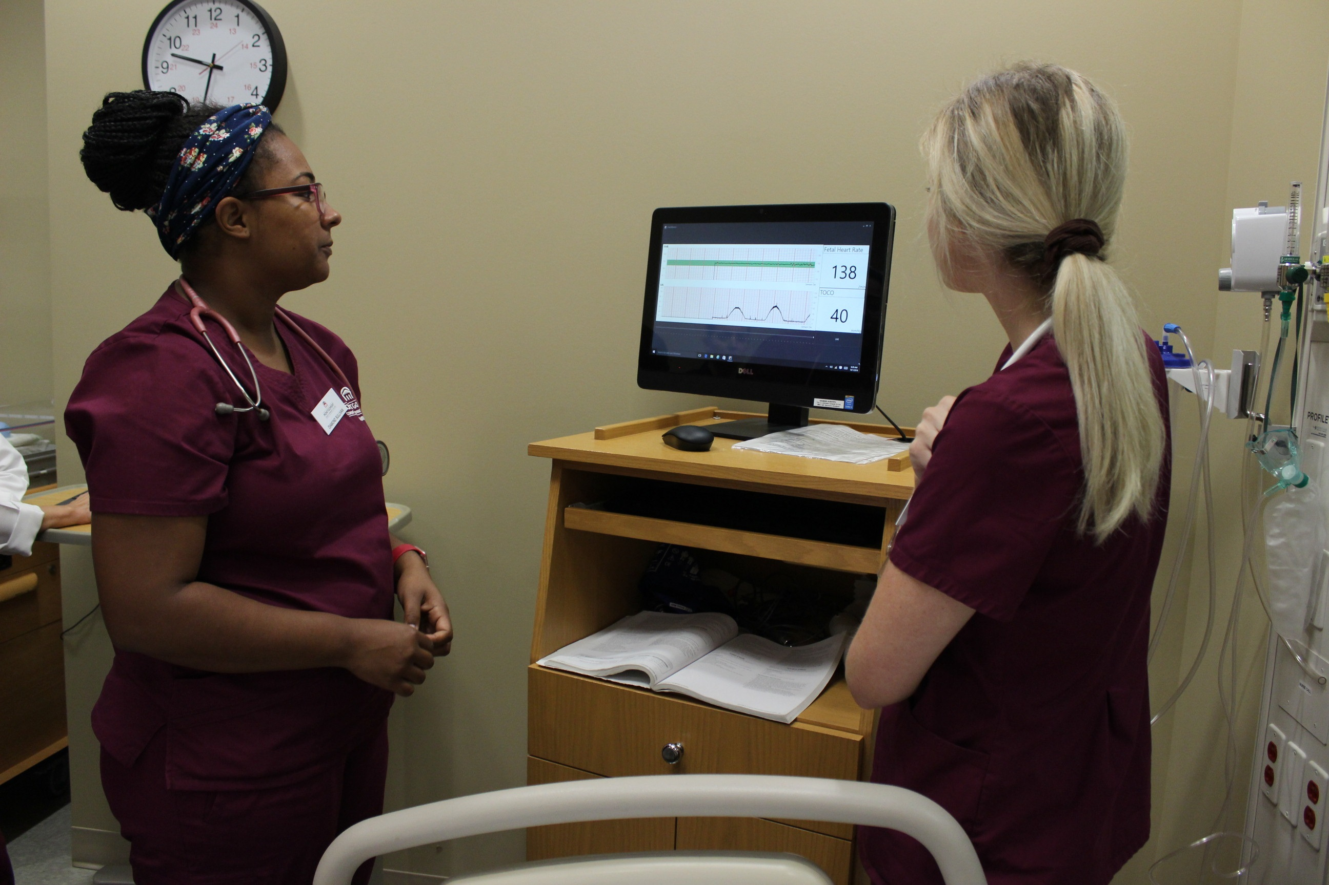
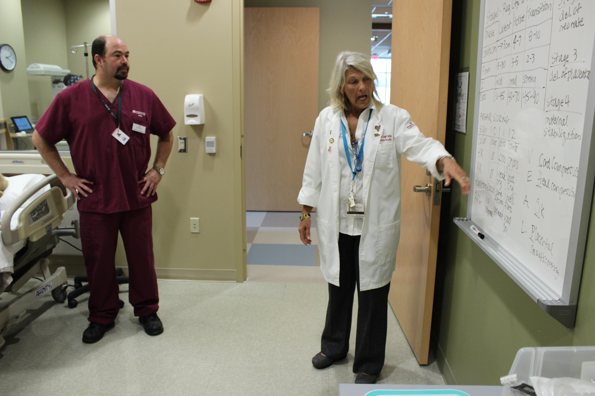
Hepatitis B Vaccine
If not immune or previously received the vaccine- need series of 3 shots
First shot- now
Second shot- one month later
Third shot- 6 months later
If getting the series now need to complete the
Hepatitis B Declination Page

Slide 15
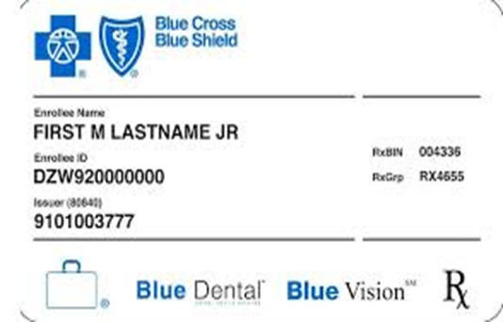
Additional Clinical Needs
Liability Insurance- Nurses Service Organization- NSO
Limits must be $1,000,000/$6,000,000- Start Date is first day of the course
Proof of Medical/Health Insurance
AHA Basic Life Support-CPR
Current Flu Shot- no exceptions- required by all clinical agencies
Although the Covid-19 Vaccine plus booster is not required by MC3 it is required by most clinical agencies
ID Badge- need photo in College System

Slide 16
Why Montgomery County Community College?
We provide clinical placement
Other programs require students to find their own clinical sites
Our program is 12-weeks
Other approved programs take 15-weeks or 7-8 months to complete

Slide 17
Important dates
Fall 2023
Information session: August 1, 2023, at 6 pm via zoom
Registration deadline: Friday, August 18, 2023
Course dates: September 18-December 14, 2023
Clinical dates: October 7-November 18
Spring 2024
Information session: January 16, 2024, at 6 pm via zoom
Registration deadline: Friday, February 2, 2024
Course dates: February 12-May 9, 2024
Clinical dates: March 9, March 23-April 27, 2024

Slide 18
How to Register?
Email nursingprogram@mc3.edu to express interest or ask questions about in enrolling in the course.
Attend the information session: August 1, 2023, 6-7 pm via zoom for fall semester or January 16, 2024, 6-7 pm via zoom for spring semester
After attending the information session, contact Denise Davidson at ddavidso@mc3.edu (Coordinator, NRR) to register. Please send a current or lapsed/expired unencumbered PA license number.
When the license is verified a Registration link will be emailed to individual
Follow the instructions within the registration link

