Slide 1
Annual Update Montgomery County Commissioners
November 3, 2022

Slide 3
Leading Through Our Values
Montgomery County Community College and its Board of Trustees will:
Educate to advance equity, opportunity and social justice in the communities we serve.
Provide quality, accessible and sustainable learning opportunities.
Innovate to support student success and the needs of our communities.
Respect our diverse contributions and lived experiences to cultivate inclusion.
Foster a culture of empathy, trust, transparency, integrity and accountability.

Slide 4
Elevating Our Commitment Through Equity, Diversity, and Belonging
INSERT EVOLVED EQUITY STATEMENT

Slide 5
By the Numbers
1,606
$486.6 million
2:1
Total County Economic Impact FY22
Return on Investment
2022 Graduates
Largest graduating class in Montco history
505 First Generation Graduates
24% BIPOC Students
Operations Spending
Construction Spending
Student Spending
Alumni Impact
For every $1.00 invested in MCCC, taxpayers will receive a cumulative value of $2.20 over the course of the students’ working lives.
Notes:
Economic Impact: June 2022 student conducted by Lightcast showing impact of FY22
Total BIPOC student is 2022 class: 386

Slide 6
Inspiration through Collaboration
The Challenger Learning Center
Advancing Montco Program
Student Wellness Center
Redefining Apprenticeships
FEMA Disaster Recovery Site
Notes:
Challenger Learning Center at Montco Pottstown
Opened August 2022
Advancing Montco Program
$1.75 million – County Recovery Funds for tuition assistance program
Student Wellness Center
Food Pantries, On-Site Services
24/7 TimelyCare
Redefining Apprenticeships
Lean & Earn Models
FEMA Disaster Recovery Site
September – November 2021

Slide 7
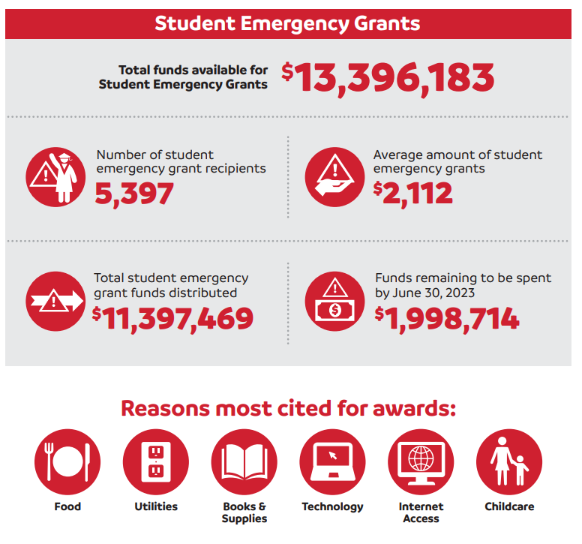
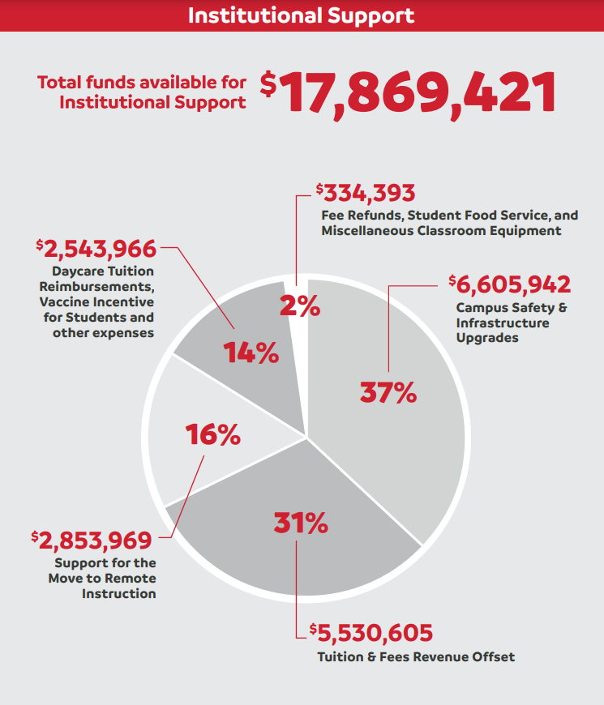
Federal Stimulus Stewardship
Notes:
Shout out to: Montgomery County Office of Public Health - Dr. Richard Lorraine, Medical Director and Christina Miller, Health Administrator, and their teams for their work in securing the public health of our communities during the COVID-19 pandemic.

Slide 8
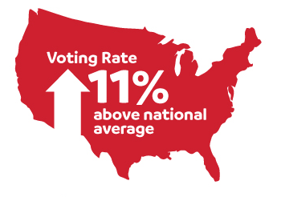
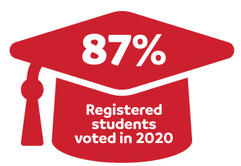
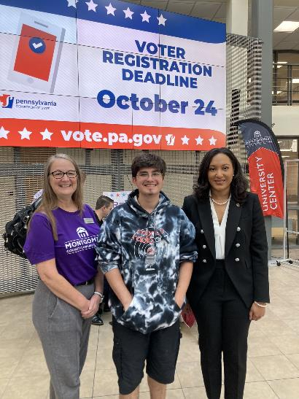
A Leader in Student Civic Engagement
Highest 2020 student voter registration and voter turnout among PA 2-year schools.
Voter Friendly Campus designation for 2021-2022 (Campus Vote Project)
Silver Seal of Excellence in Voter Engagement (ALL-IN Democracy Challenge)
Campus visit by Acting Secretary of the Commonwealth Leigh Chapman

Slide 9
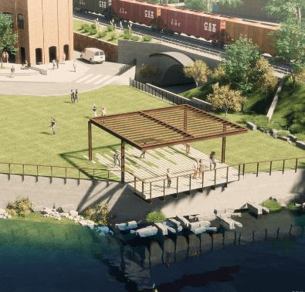
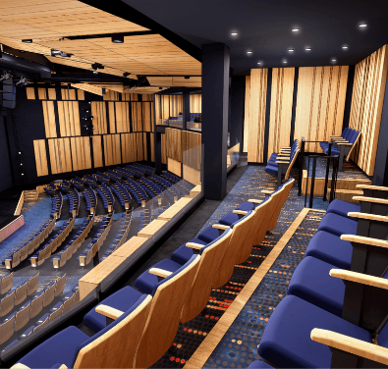
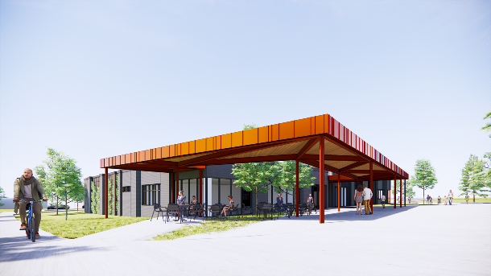
Transforming the Educational Experience
Coming Soon…
Student Wellness Center Opening
Science Center Grand Reopening
Pottstown Campus Redesign
Greenspace, Trails & Gateway project
South Hall Renovations
Science on a Sphere
Voyage Mark II Solar System Exhibit
Hospitality Institute Opening
Blue Bell Athletic Fields Upgrade

Slide 10
Thank You! View the full report at: mc3.edu/YearInReview

